Slide 1



APEX INSTITUTE OF TECHNOLOGY
DEPARTMENT OF COMPUTER SCIENCE & ENGINEERING
Machine Learning (21CSH-286)
Faculty: Prof. (Dr.) Madan Lal Saini(E13485)
Lecture – 16-17
Decision Tree and Random Forest
DISCOVER . LEARN . EMPOWER

Slide 2
DBMS: Course Objectives
COURSE OBJECTIVES
The Course aims to:
Understand and apply various data handling and visualization techniques.
Understand about some basic learning algorithms and techniques and their applications, as well as general questions related to analysing and handling large data sets.
To develop skills of supervised and unsupervised learning techniques and implementation of these to solve real life problems.
To develop basic knowledge on the machine techniques to build an intellectual machine for making decisions behalf of humans.
To develop skills for selecting suitable model parameters and apply them for designing optimized machine learning applications.

Slide 3
COURSE OUTCOMES
On completion of this course, the students shall be able to:-
CO1 | Understand machine learning techniques and computing environment that are suitable for the applications under consideration.
CO2 | Understand data pre-processing techniques and apply these for data cleaning.
CO3 | Identify and implement simple learning strategies using data science and statistics principles.
CO4 | Evaluate machine learning model’s performance and apply learning strategy to improve the performance of supervised and unsupervised learning model.
CO5 | Develop a suitable model for supervised and unsupervised learning algorithm and optimize the model on the expected accuracy.

Slide 4
Unit-2 Syllabus
Unit-2 | Supervised Learning | Contact Hours: 10 Hours
Regression | Linear regression, Ridge Regression, Lasso Regression, and Bayesian Linear Regression.
Classification | Types of Classification Algorithm: Binary Classification and Multi-Class Classification, Logistic Regression, K-Nearest Neighbours, Decision Trees, Random Forest, Support Vector Machine.
Performance Metrics | Performance metrics for Regression: Mean Absolute Error, Mean Squared Error, Root Mean Squared Error, R-Squared; Performance metrics for classification: Confusion Matrix, Accuracy, Precision, Recall, F1 score.

Slide 5
SUGGESTIVE READINGS
TEXT BOOKS:
T1: Tom.M.Mitchell, “Machine Learning, McGraw Hill International Edition”.
T2: Ethern Alpaydin,” Introduction to Machine Learning. Eastern Economy Edition, Prentice Hall of India, 2005”.
T3: Andreas C. Miller, Sarah Guido, Introduction to Machine Learning with Python, O’REILLY (2001).
REFERENCE BOOKS:
R1 Sebastian Raschka, Vahid Mirjalili, Python Machine Learning, (2014)
R2 Richard O. Duda, Peter E. Hart, David G. Stork, “Pattern Classification, Wiley, 2nd Edition”.
R3 Christopher Bishop, “Pattern Recognition and Machine Learning, illustrated Edition, Springer, 2006”.

Slide 6
Abstract
Random forests (RF) are a combination of tree predictors such that each tree depends on the values of a random vector sampled independently and with the same distribution for all trees in the forest.
The generalization error of a forest of tree classifiers depends on the strength of the individual trees in the forest and the correlation between them.
Using a random selection of features to split each node yields error rates that compare favorably to Adaboost, and are more robust with respect to noise.

Slide 7
Introduction
Improvements in classification accuracy have resulted from growing an ensemble of trees and letting them vote for the most popular class.
To grow these ensembles, often random vectors are generated that govern the growth of each tree in the ensemble.
Several examples: bagging (Breiman, 1996), random split selection (Dietterich, 1998), random subspace (Ho, 1998), written character recognition (Amit and Geman, 1997)

Slide 8


Introduction (Cont.)

Slide 9
Introduction (Cont.)
After a large number of trees is generated, they vote for the most popular class. We call these procedures random forests.

Slide 10
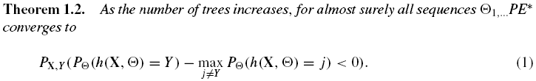
Characterizing the accuracy of RF
Margin function:
which measures the extent to which the average number of votes at X,Y for the right class exceeds the average vote for any other class. The larger the margin, the more confidence in the classification.
Generalization error:

Slide 11


Characterizing… (Cont.)
Margin function for a random forest:
strength of the set of classifiers is
suppose is the mean value of correlation
the smaller,
the better

Slide 12
Using random features
Random split selection does better than bagging; introduction of random noise into the outputs also does better; but none of these do as well as Adaboost by adaptive reweighting (arcing) of the training set.
To improve accuracy, the randomness injected has to minimize the correlation while maintaining strength.
The forests consists of using randomly selected inputs or combinations inputs at each node to grow each tree.

Slide 13
Using random features (Cont.)
Compared with Adaboost, the forests discussed here have following desirable characteristics:
--- its accuracy is as good as Adaboost and sometimes better;
--- it’s relatively robust to outliers and noise;
--- it’s faster than bagging or boosting;
--- it gives useful internal estimates of error, strength, correlation and variable importance;
--- it’s simple and easily parallelized.

Slide 14
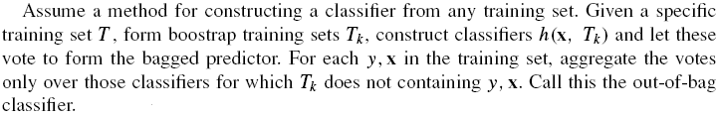
Using random features (Cont.)
The reason for using out-of-bag estimates to monitor error, strength, and correlation:
--- can enhance accuracy when random features are used;
--- can give ongoing estimates of the generalization error (PE*) of the combined ensemble of trees, as well as estimates for the strength and correlation.

Slide 15
Random forests using random input selection (Forest-RI)
The simplest random forest with random features is formed by selecting a small group of input variables to split on at random at each node.
Two values of F (number of randomly selected variables) were tried: F=1 and F= int( ), M is the number of inputs.
Data set: 13 smaller sized data sets from the UCI repository, 3 larger sets separated into training and test sets and 4 synthetic data sets.

Slide 16
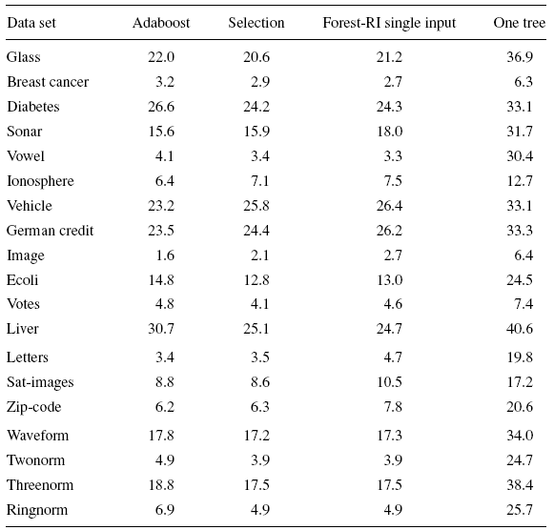
Forest-RI (Cont.)

Slide 17
Forest-RI (Cont.)
2nd column are the results selected from the two group sizes by means of lowest out-of-bag error.
3rd column is the test error using one random feature to grow trees.
4th column contains the out-of-bag estimates of the generalization error of the individual trees in the forest computed for the best setting.
Forest-RI > Adaboost.
Not sensitive to F.
Using a single randomly chosen input variable to split on at each node could produce good accuracy.
Random input selection can be much faster than either Adaboost or Bagging.

Slide 18
Random forests using linear combinations of inputs (Forest-RC)
Defining more features by taking random linear combinations of a number of the input variables. That is, a feature is generated by specifying L, the number of variables to be combined. At a given node, L variables are randomly selected and added together with coefficients that are uniform random numbers on [-1,1]. F linear combinations are generated, and then a search is made over these for the best split. This procedure is called Forest-RC.
We use L=3 and F=2,8 with the choice for F being decided on by the out-of-bag estimate.

Slide 19
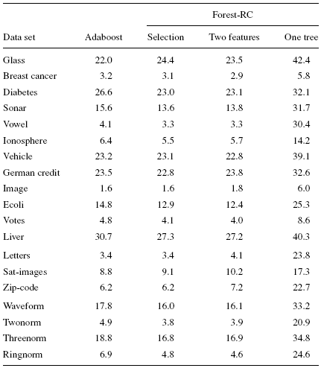
Forest-RC (Cont.)
The 3rd column contains the results for F=2.
The 4th column contains the results for individual trees.
Overall, Forest-RC compares more favorably to Adaboost than Forest-RI.

Slide 20
Empirical results on strength and correlation
To look at the effect of strength and correlation on the generalization error.
To get more understanding of the lack of sensitivity in PE* to group size F.
Using out-of-bag estimates to monitor the strength and correlation.
We begin by running Forest-RI on the sonar data (60 inputs, 208 examples) using from 1 to 50 inputs. In each iteration, 10% of the data was split off as a test set. For each value of F, 100 trees were grown to form a random forest and the terminal values of test set error, strength, correlation are recorded.

Slide 21
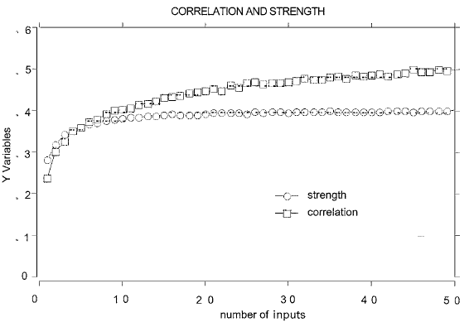
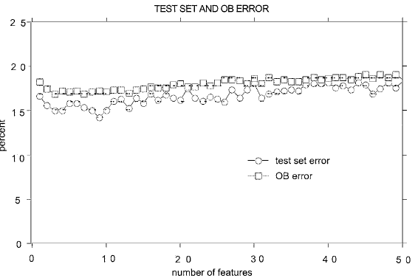

Slide 22
Some conclusions
More experiments on breast data set (features consisting of random combinations of three inputs) and satellite data set (larger data set).
Results indicate that better random forests have lower correlation between classifiers and higher strength.

Slide 23
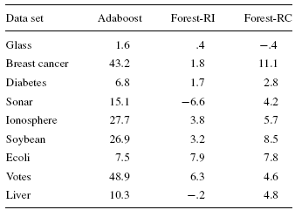
The effects of output noise
Dietterich (1998) showed that when a fraction of the output labels in the training set are randomly altered, the accuracy of Adaboost degenerates, while bagging and random split selection are more immune to the noise. Increases in error rates due to noise:

Slide 24
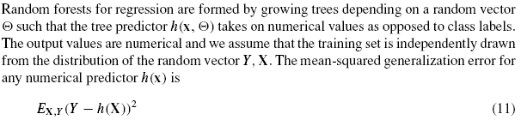

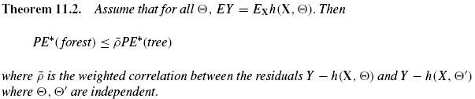
Random forests for regression

Slide 25
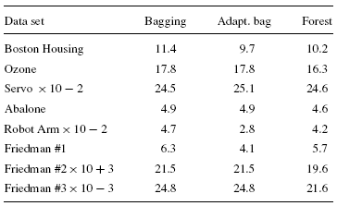
Empirical results in regression
Random forest-random features is always better than bagging. In datasets for which adaptive bagging gives sharp decreases in error, the decreases produced by forests are not as pronounced. In datasets in which adaptive bagging gives no improvements over bagging, forests produce improvements.
Adding output noise works with random feature selection better than bagging

Slide 26
Conclusions
Random forests are an effective tool in prediction.
Forests give results competitive with boosting and adaptive bagging, yet do not progressively change the training set.
Random inputs and random features produce good results in classification- less so in regression.
For larger data sets, we can gain accuracy by combining random features with boosting.

